Slide 1

UNIVERSITY OF THESSALY
DEPARTMENT OF ELECTRICAL AND COMPUTER ENGINEERING
UNSUPERVISED MACHINE LEARNING FOR REAL-TIME NETWORK INTRUSION DETECTION: NETWORK IMPLEMENTATION, ATTACK SIMULATION AND AI ENCHANCEMENT
FULL NAME: MOYSIS MOYSIS
SUPERVISOR: ANTONOPOULOS CHRISTOS

Slide 2
Outline
Introduction
Background
Related Work
Datasets and Feature Selection
Methodology and Architecture
System Prototype
Evaluation and Results
Conclusion

Slide 3
INTRODUCTION

Slide 4
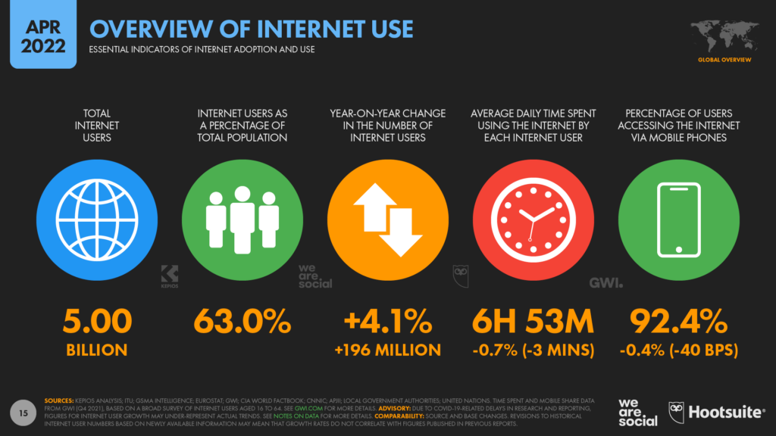
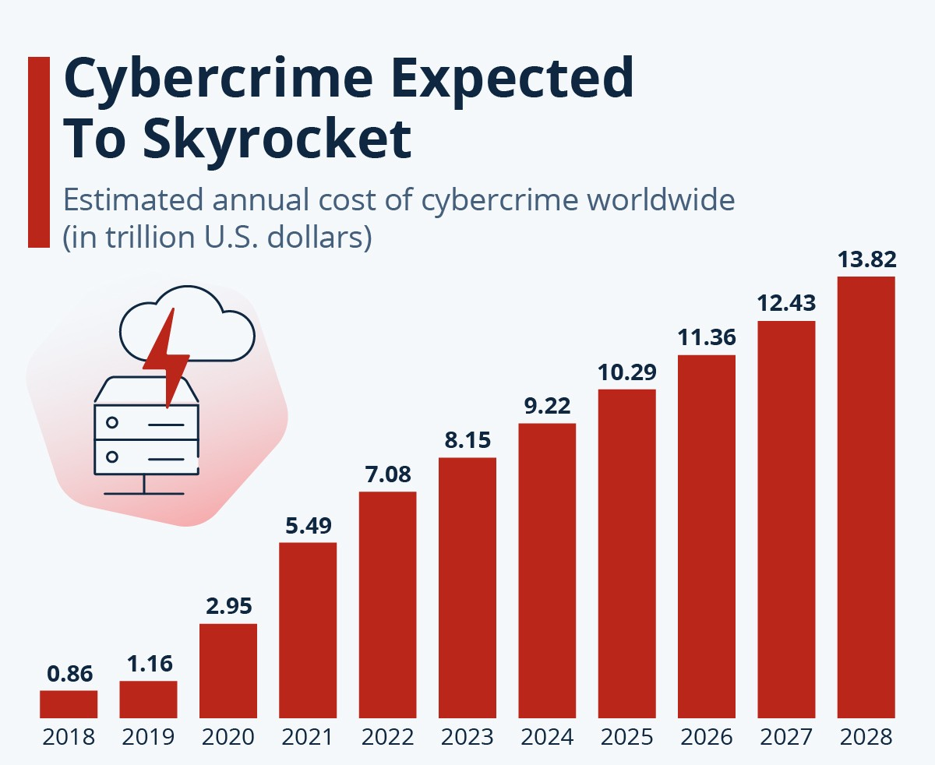
Why we need smarter IDS
Massive data and device growth increases exposure to cyber threats.
Signature-based IDS fails on zero-day attacks.
Modern cyber threats require intelligent and adaptive detection methods.
This thesis explores real-time anomaly detection using unsupervised machine learning.

Slide 5
Thesis Contribution
Scientific
Engineering
Practical
Detects both known and unknown attack patterns.
Uses unsupervised learning for anomaly detection.
Implemented a hybrid approach.
Real-time intrusion detection.
No need for costly or high-performance infrastructure.
Modular system design allows integration with other tools or systems.
Proactive, automated defense in real-world networks.
Blueprint for ML-driven IDS.
Reduction of human burden.
Reduction in breach costs and downtime.

Slide 6
BACKGROUND

Slide 7
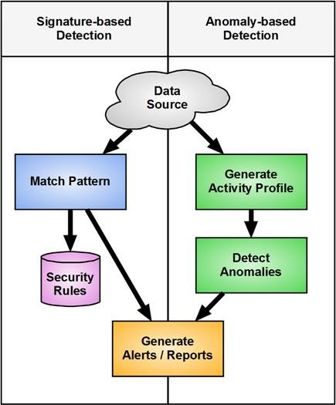
Intrusion Detection in Cybersecurity
Signature-based
Anomaly-based
Requires labeled data
Detects known attacks
Fails on unknown threats
Learns only from normal data
Can detect zero-day attacks
Can produce more false positives

Slide 8
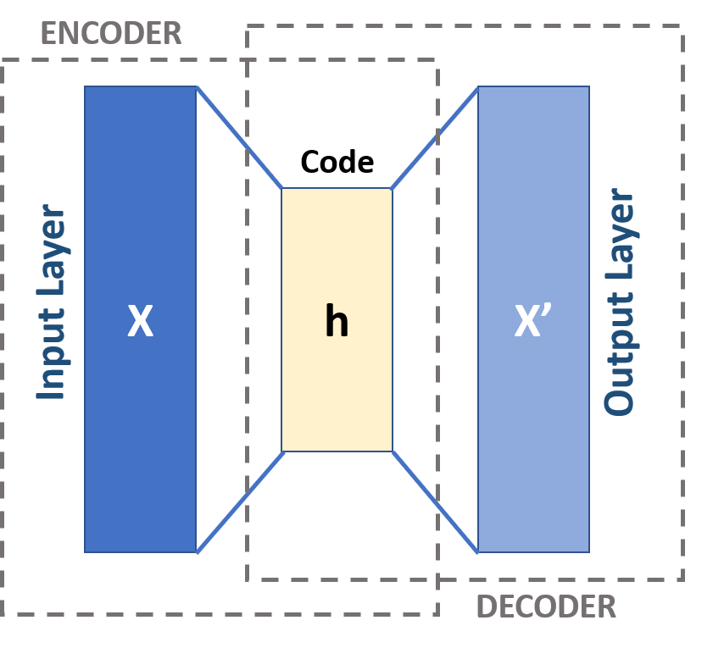
Autoencoders
Unsupervised machine learning
Reconstructs the input
Lightweight and suitable for real-time

Slide 9
RELATED WORK

Slide 10
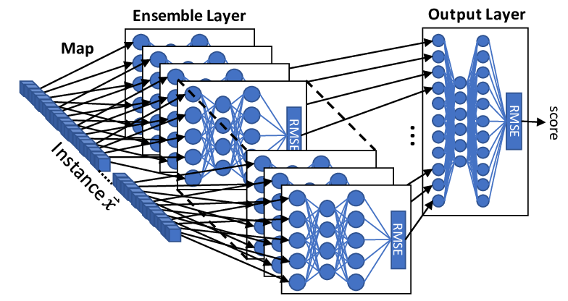
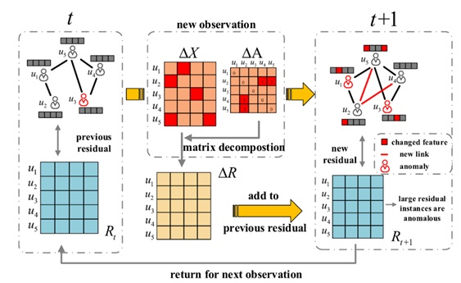
Kitsune & AnomalyDAE
Kitsune: An ensemble of Autoencoders for Online Network Intrusion Detection
AnomalyDAE: Dual autoencoder for anomaly detection on attributed networks

Slide 11
DATASETS AND FEATURE SELECTION

Slide 12
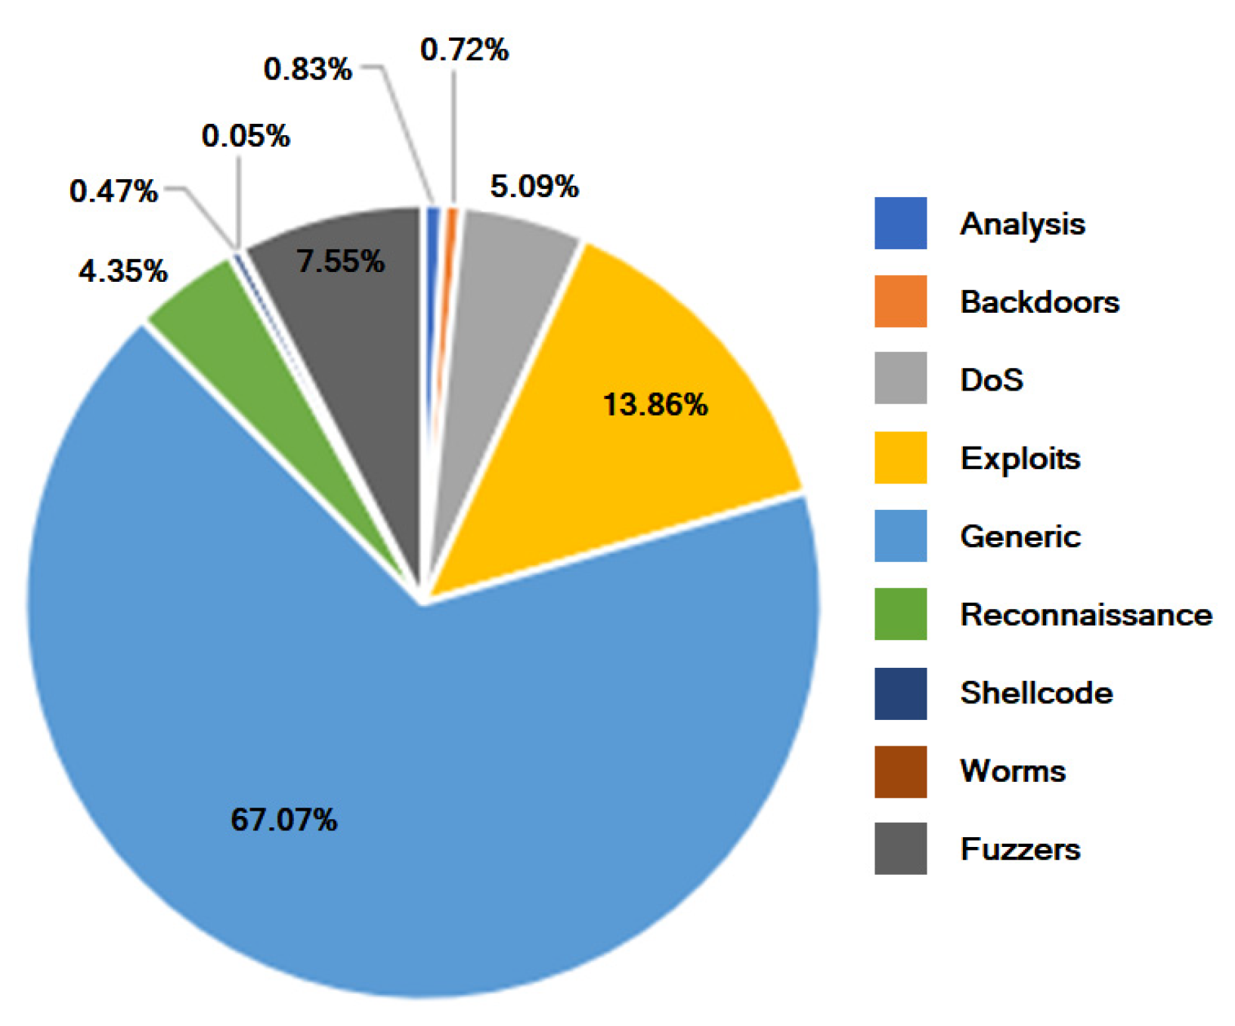
Datasets Overview
UNSW-NB15
Kyoto 2006+
Distinct perpsectives.
The combination ensures broader coverage
vs
Simulated
Real-world
Labeled
Partially labeled
Normal + 9 attack types
Real traffic

Slide 13
Feature Selection
All selected features can be obtained real-time.
Features were derived from UNSW-NB15 dataset.
Selected features had no missing values.
Feature | Description
dur | Duration of the flow (seconds)
proto | Transport-layer protocol
state | Connection state
spkts | Packets sent by the source
dpkts | Packets received by the destination
sbytes | Bytes sent from source to destination
Feature | Description
dbytes | Bytes sent from destination to source
sload | Average bits/second from source to destination
sttl | Time to live (TTL) value from source
dttl | TTL value from destination
dload | Average bits/second from destination to source

Slide 14
METHODOLOGY AND ARCHITECTURE

Slide 15
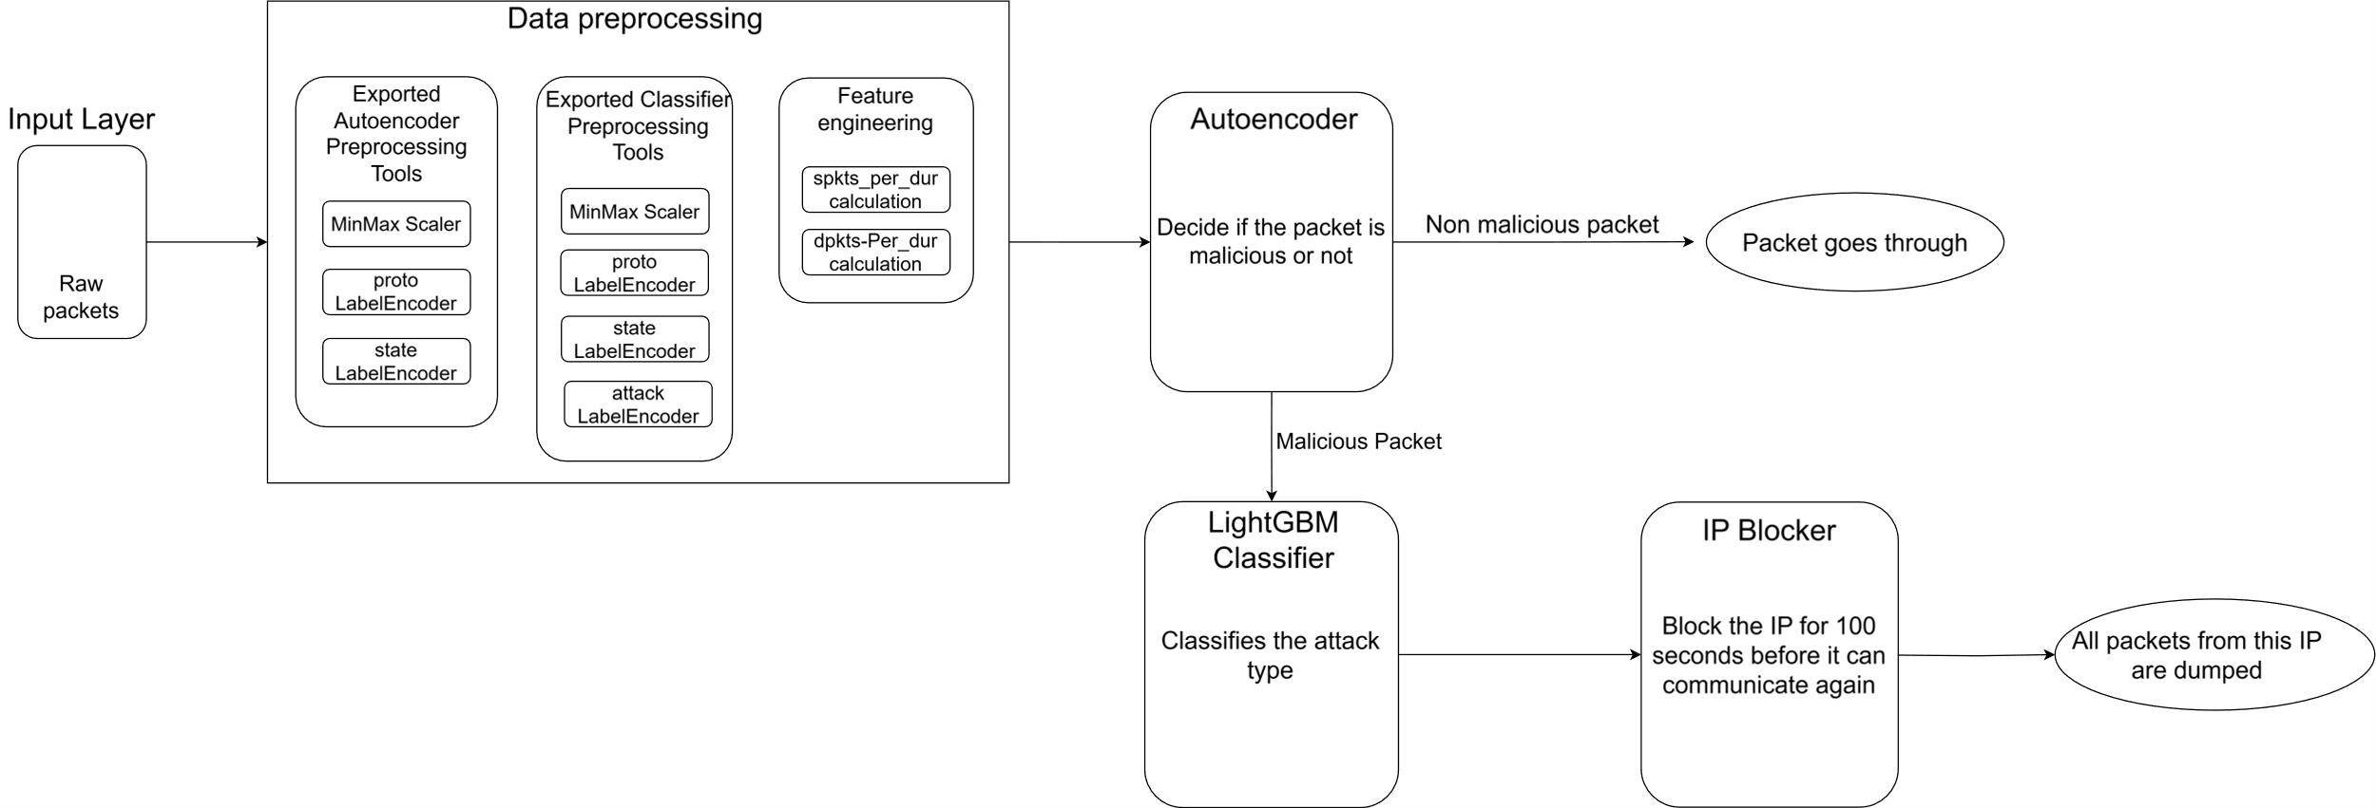
System Overview

Slide 16
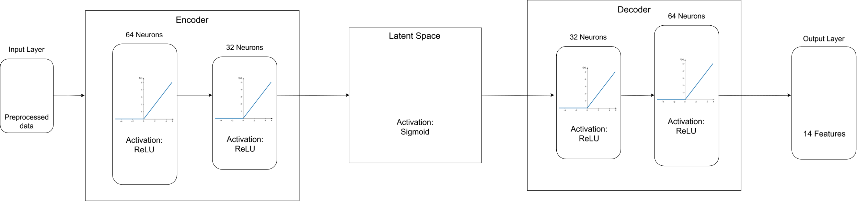
Autoencoder Anomaly Detection System
Advantages
Training and Optimization
Detection of unknown/zero-day attacks
Robust to noise
Scalability and efficiency
Loss function: Mean Squared Error
Optimizer: Adam, learning rate 0.001
Epochs: 100 maximum with early stopping

Slide 17
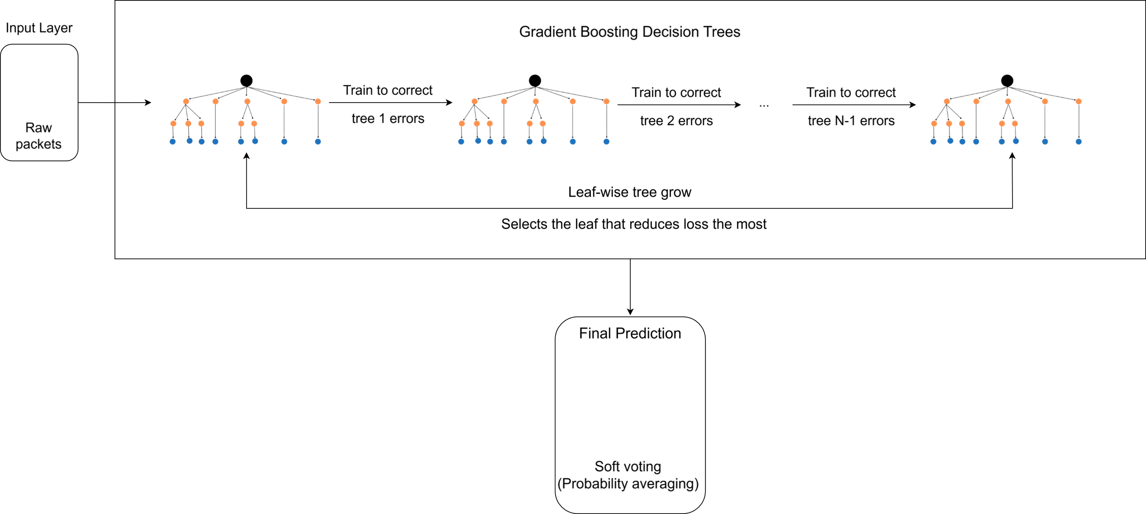
LightGBM Attack Classifier System
Training and Optimization
GridSearchCV was used in training
Learning Rate: 0.05
Number of leaves: 31
Max Depth: 15

Slide 18
SYSTEM PROTOTYPE

Slide 19
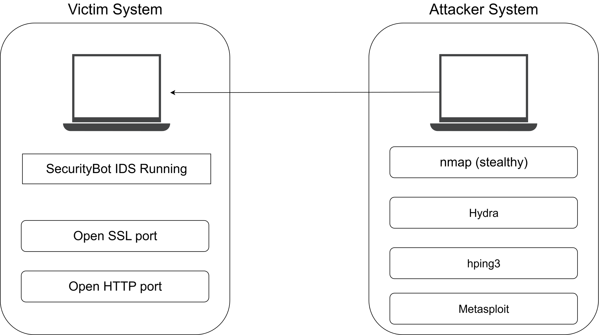
System Environment
Machines
Victim Machine: Ubuntu 20.04 LTS
Attacker Machine: Kali Linux 2021.4
Network Interface
Network Interface: ens33
Traffic Monitoring: Integrated Network Interface Card

Slide 20
Tools Used
Model Implementation
Attack Simulation
Scappy: Packet-sniffing
nmap: Network scanning and reconnaissance
Tensorflow/Keras: Model implementation
Metasploit: Exploitation
Scikit-learn: Data preprocessing and Evaluation
Hydra: Brute force attacks
Imbalanced-learn: Class imbalance
Joblib: Model saving and loading
iptables: IP Blocking and unblocking.

Slide 21
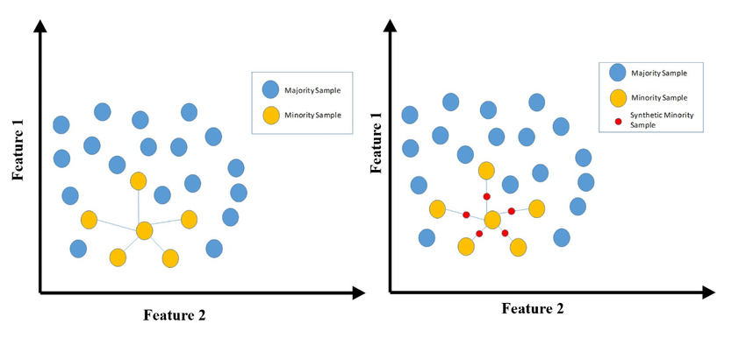
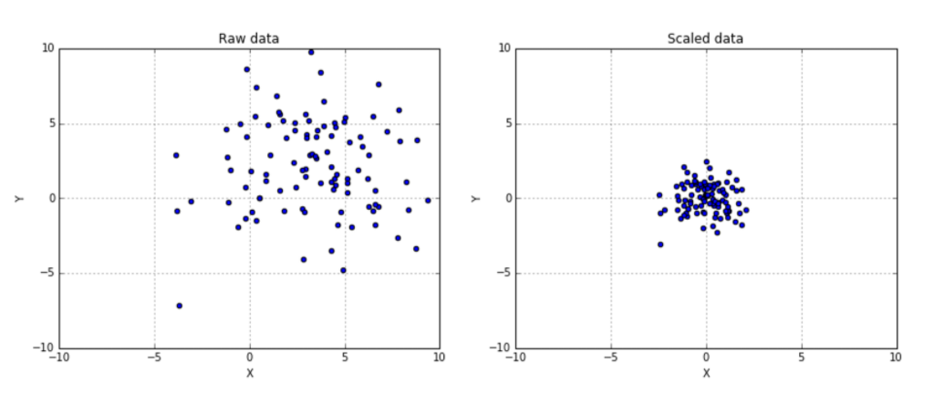
Data Preprocessing
Data preprocessing pipeline includes:
Data Cleaning and Handling Missing Values
Feature encoding
Feature scaling and normalization
Data splitting
Dealing with class imbalance (SMOTE)

Slide 22
Challenges and Limitations
Data quality and availability
Model complexity and overfitting
Scalability and real-time processing
False positives and negatives

Slide 23
EVALUATION AND RESULTS

Slide 24
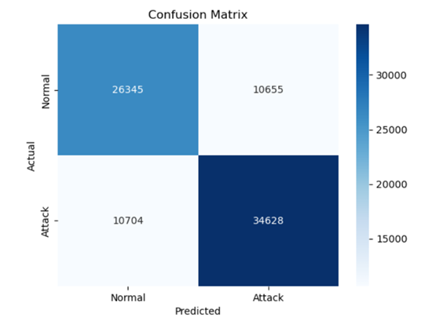
Anomaly Detection System Performance
Class | Precision | Recall | F1-Score
0 (Normal) | 78% | 76% | 77%
1 (Attack) | 77% | 79% | 77%

Slide 25
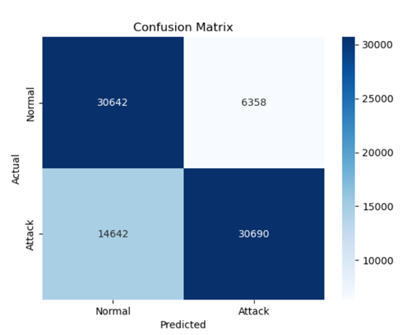
Dual Autoencoder System Performance
Class | Precision | Recall | F1-Score
0 (Normal) | 78% | 77% | 77%
1 (Attack) | 84% | 82% | 80%

Slide 26
Attack Classifier System Performance
Class | Precision | Recall | F1-Score | Samples
Exploits | 90% | 87% | 83% | 11.132
Generic | 100% | 100% | 100% | 18.871
Normal | 94% | 90% | 90% | 37.000
DoS | 70% | 65% | 70% | 4089
Fuzzers | 82% | 81% | 79% | 6062
Backdoor | 40% | 40% | 40% | 583
Worms | 8% | 27% | 21% | 44
Shellcode | 11% | 37% | 17% | 378
Reconnaissance | 78% | 57% | 60% | 3496
Class | Precision | Recall | F1-Score | Samples
Exploits | 91% | 89% | 90% | 11.132
Generic | 100% | 100% | 100% | 18.871
Normal | 94% | 90% | 90% | 37.000
DoS | 74% | 72% | 73% | 4089
Fuzzers | 85% | 84% | 84% | 6062
Backdoor | 65% | 62% | 63% | 583
Worms | 47% | 50% | 48% | 44
Shellcode | 51% | 59% | 54% | 378
Reconnaissance | 83% | 72% | 77% | 3496

Slide 27
CONCLUSION

Slide 28
Key Takeaways
Data Quality
Unsupervised learning is not shortcut
Real-time ≠ offline systems
Cybersecurity evolves

Slide 29
Bibliography
[1] S. Kemp, “Digital 2022: April Global Statshot Report,” *DataReportal*, 21 Apr. 2022. [Online].
Available: https://datareportal.com/reports/digital-2022-april-global-statshot
[2] A. Fleck, “Expected global cost of cybercrime from 2017 to 2027,” Statista, Feb. 22, 2024. [Online].
Available: https://www.statista.com/chart/28878/expected-cost-of-cybercrime-until-2027/
[3] R. Fekolkin, “Intrusion Detection and Prevention Systems: Overview of Snort and Suricata,” Internet Security, A7011N, Luleå University of Technology, Sweden, Jan. 6, 2015. [Online].
Available: https://www.researchgate.net/publication/297171228_Intrusion_Detection_and_Prevention_Systems_Overview_of_Snort_and_Suricata
[4] Wikipedia, "Wikipedia," [Online]. Available: https://en.wikipedia.org/wiki/Autoencoder
[5] Y. Mirsky, T. Doitshman, Y. Elovici and A. Shabtai, "Kitsune: An Ensemble of Autoencoders for Online," NDSS Symposium, Negev, 2018.
[6] F. Haoyi, F. Zhang and Z. Li, "AnomalyDAE: Dual autoencoder for anomaly detection on attributed networks," ICASSP2020, Harbin, 2020.
[7] S. Bagui, M. Walauskis, R. DeRush, H. Praviset, and S. Boucugnani, “Spark Configurations to Optimize Decision Tree Classification on UNSW‑NB15,” *Big Data and Cognitive Computing*, vol. 6, no. 2, art. 38, Apr. 2022, doi: 10.3390/bdcc6020038.

Slide 30



Thank you!
Moysis Moysis
+30 6942298512
mmoysis@uth.gr

